Slide 1

Optimal implementations of UPGMA and other common clustering algorithm
Ilan Gronau, Shlomo Moran
Information Processing Letters 104 (2007) 205-210
Presenter: Chung, Wei-Chun
Date: Tuesday, February 19, 2008

Slide 2

Abstract
In this work we consider hierarchical clustering algorithms, such as UPGMA, which follow the closest-pair joining scheme. We survey optimal O(n²)-time implementations of such algorithms which use a ‘locally closest’ joining scheme, and specify conditions under which this relaxed joining scheme is equivalent to the original one (i.e. ‘globally closest’).

Slide 3
Outline
Introduction
Efficient implementations of clustering algorithms using nearest neighbors
Equivalence of the LCP and GCP schemes

Slide 4
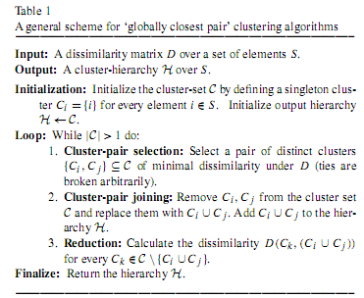
Scheme

Slide 5



Variants
UPGMA (Unweighted Pair Grouping Method with Arithmetic-mean)
WPGMA
Single-Linkage

Slide 6
Convex GCP Algorithms
The value set for D(C_{k},(C_{i} ∪ C_{j} )) lies between D(C_{k},C_{i} ) and D(C_{k},C_{j} ).
  The reducibility property
    if D( C_{i} ,C_{j} ) ≦ min{D( C_{k},C_{i} ),D( C_{k},C_{j} )}, then min{D( C_{k},C_{i} ), D( C_{k},C_{j} )} ≦ D( C_{k},( C_{i} ∪ C_{j} ))
i
i
i,j
k
k
j
j

Slide 7
GCP V.S. LCP
A natural question raised by this relaxation in the clustering scheme is whether the resulted LCP algorithms are equivalent to the original GCP algorithms, in the sense that they have the same input–output relation.

Slide 8
Outline
Introduction
Efficient implementations of clustering algorithms using nearest neighbors
Equivalence of the LCP and GCP schemes

Slide 9
Nearest-neighbor (NN)
Cluster C_{j} is said to be a nearest-neighbor (NN) of C_{i} if it is closest to it.
  O(n²) implementations of GCP algorithms using nearest-neighbors are known in some special cases.

Slide 10
Reciprocal nearest-neighbors (RNNs)
Finding RNNs can be easily done by maintaining a complete nearest-neighbor chain.
A sequence of distinct clusters P = (C_{i1} ,C_{i2} ,...,C_{il}) is a nearest-neighbor chain (with respect to D) if C_{ir}+1 = NN(C_{ir}) for all 1 ≦ r ＜ l.
  A NN-chain is said to be complete if it contains at least two clusters, and the last two clusters are RNNs.

Slide 11
Outline
Introduction
Efficient implementations of clustering algorithms using nearest neighbors
Equivalence of the LCP and GCP schemes

Slide 12

Lemma

Slide 13
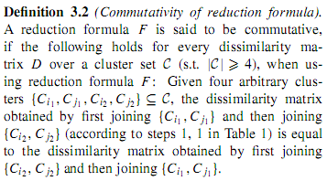
Property - commutativity

Slide 14
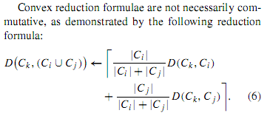
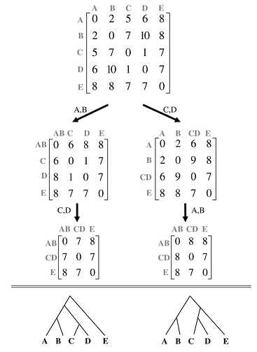
Property - commutativity

Slide 15
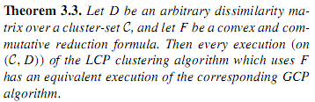
Theorem
It implies that every GCP clustering algorithm which uses a reduction formula which is both convex and commutative can be implemented by the NN-chain technique.
This includes many common variants, such as UPGMA, WPGMA and the single linkage algorithm.

